Slide 1


Slide 2







Team
Ândrei Schuch
Gabriel Fonseca
Guilherme Quadros
Edson Rocha
Pablo Parada
Game Design
Engineering
Testing
Engineering
UI
Game Design
Engineering
Testing
Script
Animation
3D Art
Animation

Slide 3
A cartoonish multiplayer zombie beat’ em up.

Slide 4
A cartoonish multiplayer zombie beat’ em up.
Just run and shoot!!!

Slide 5
Brief
Who doesn't like chocolate?

Slide 6
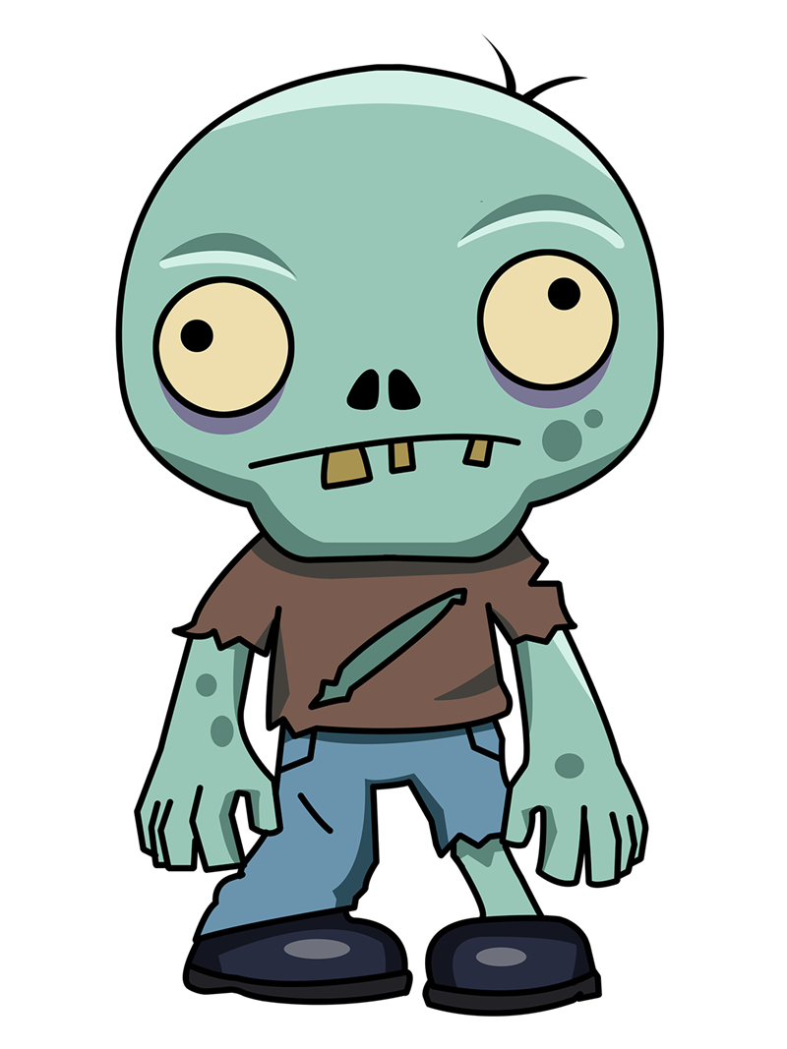

Brief
+

Slide 7
Brief
A new chocolate just turned everyone into zombies and the city is upside down.
Notes:
Aqui o Edson deve falar sobre as inspirações para o roteiro.

Slide 8
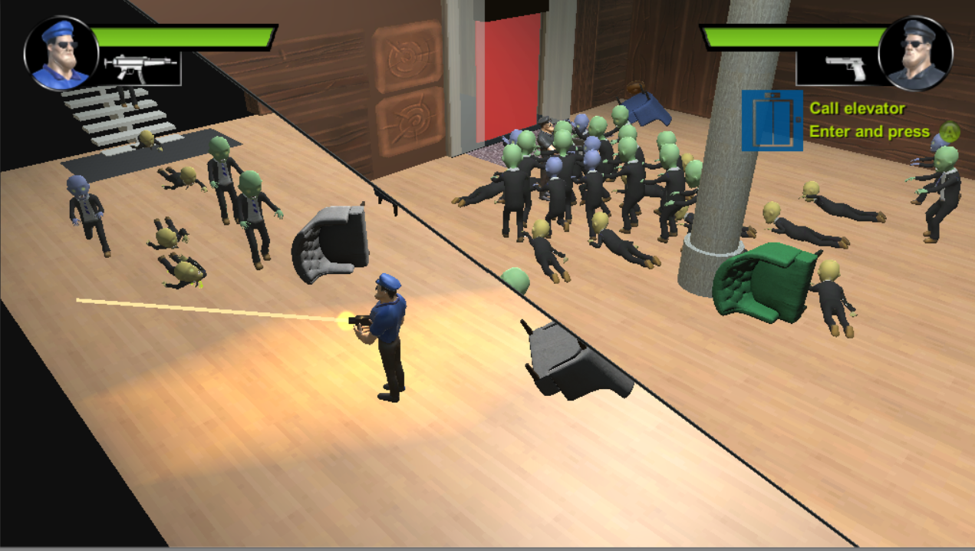
Local Multiplayer

Slide 9
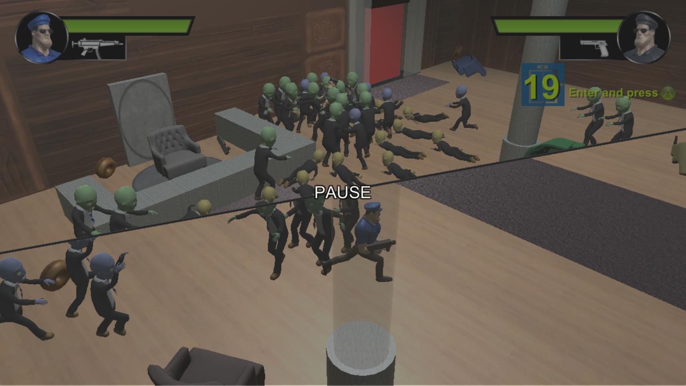
Dynamic Split screen

Slide 10
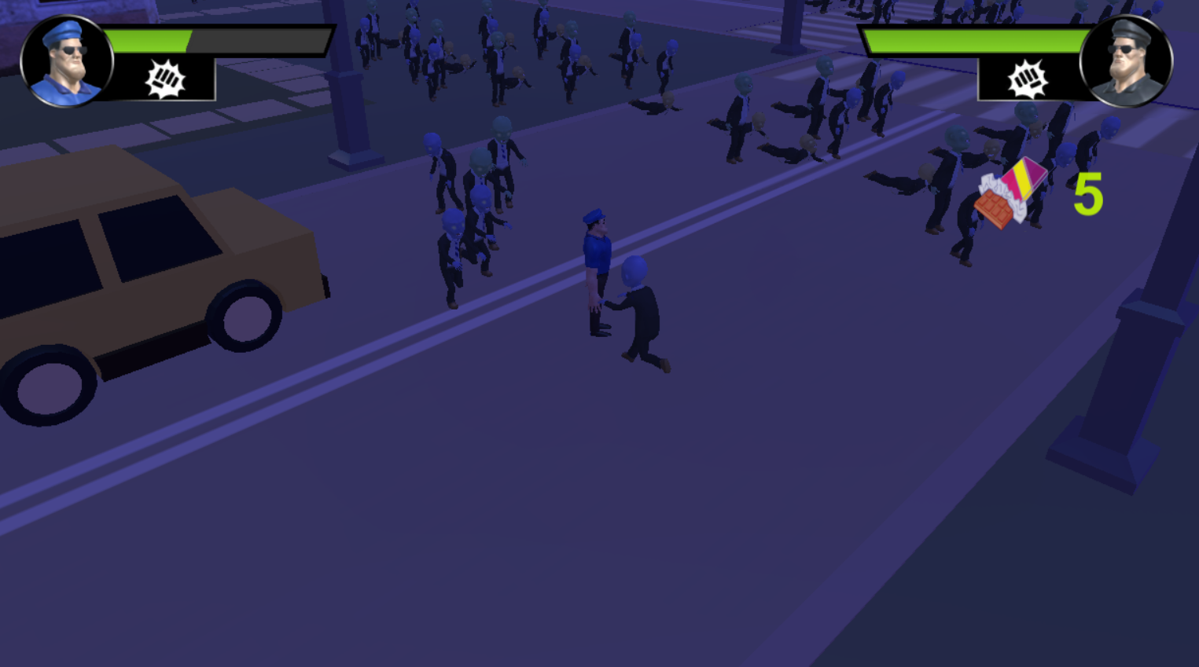
Cartoonish Looking

Slide 11
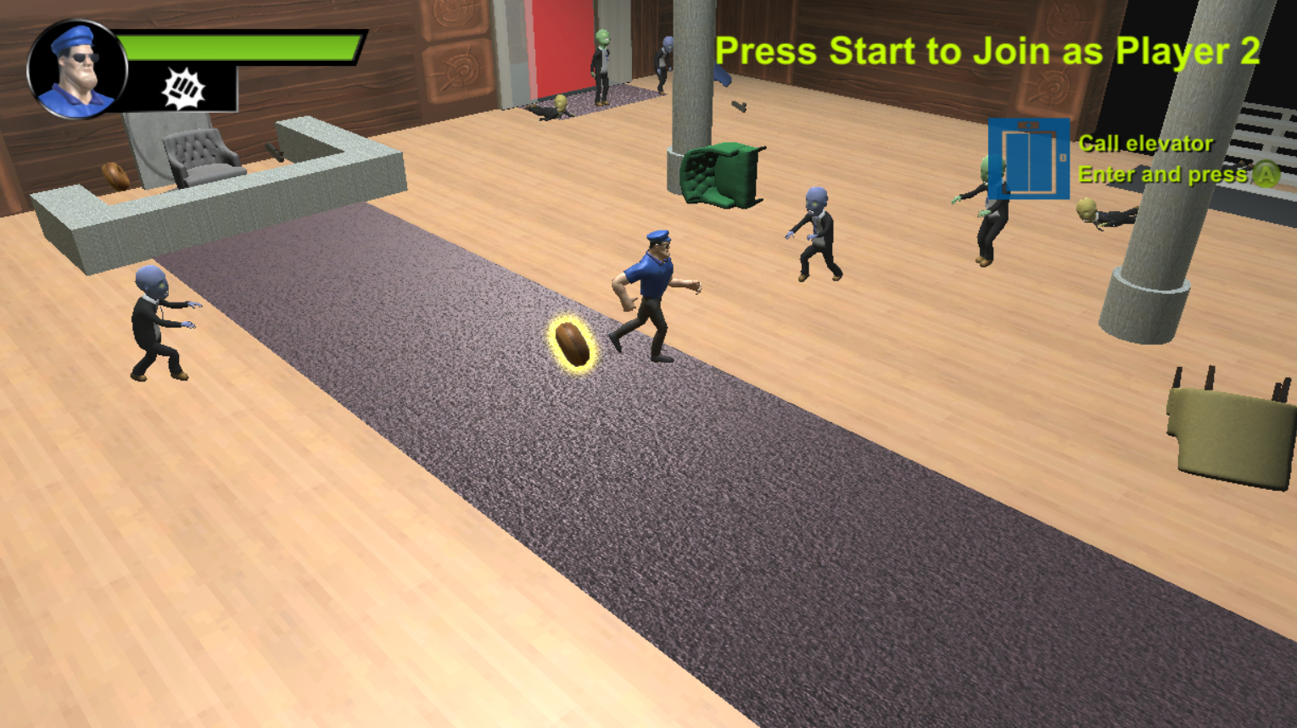
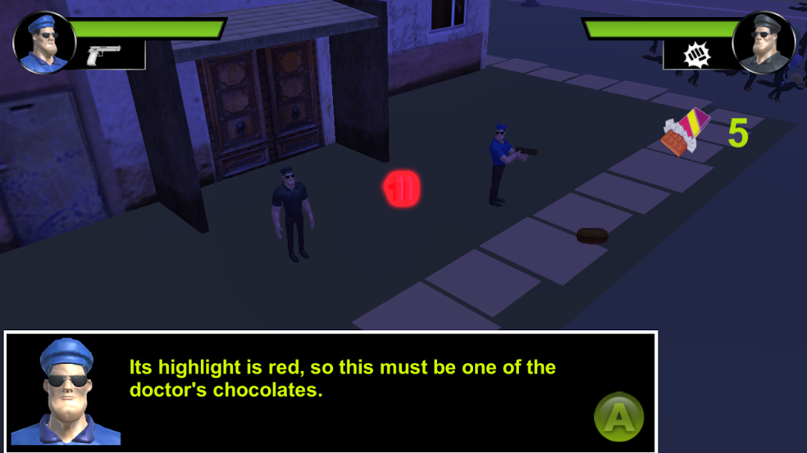
Collect Items

Slide 12
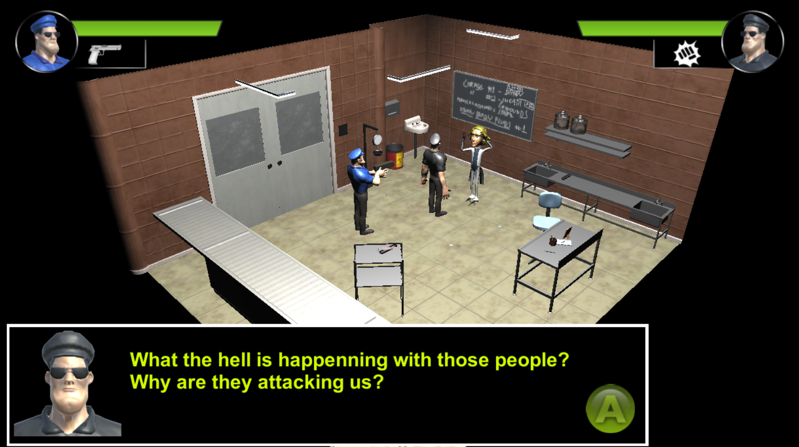
Save the world

Slide 13
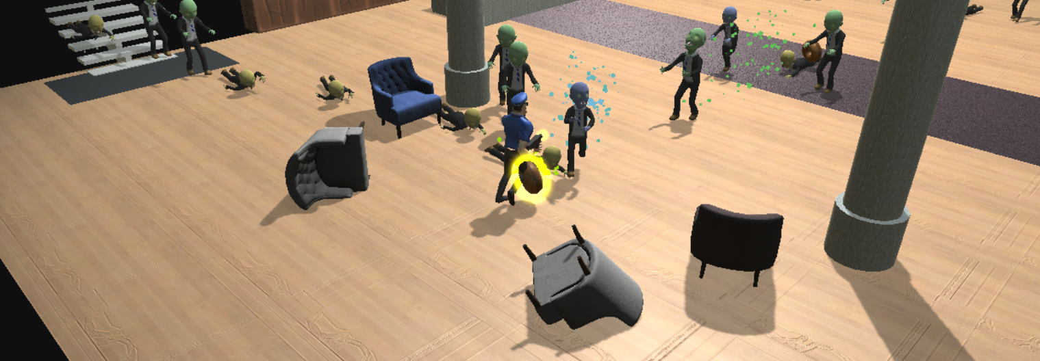
And shoot every zombie you can...

Slide 14
Game
Zombie Beat’ em Up
Cartoonish Looking
Multi-platform
PC
Xbox One (to be supported)
Local Multiplayer
Notes:
“to be supported” = problemas no build UWP, ao que parece uma das últimas atualizações do Windows 10 quebrou o build UWP do Unity para todas as plataformas. E para a apresentação só conseguimos gera o build pra PC.

Slide 15
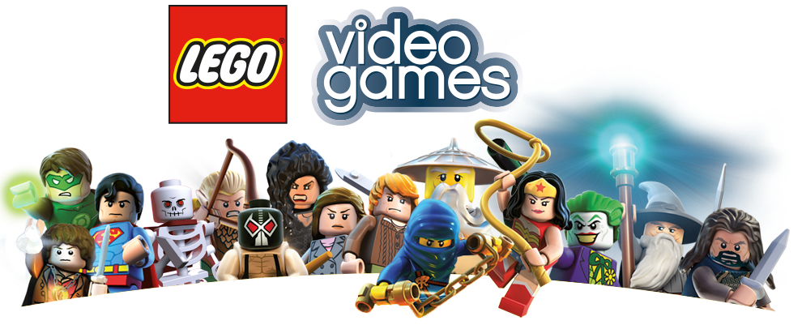

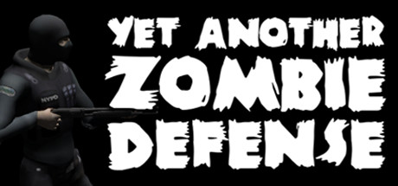
Inspirations
Lego Series
Left 4 Dead Series
Yet Another Zombie Defense
10mi units sold
Local Multiplayer
Dynamic Split Screen
Action + Comedy
21.4mi units sold
Zombie types
Zombie IA
Guns
662k units sold
Player movimentation
Zombie types
Guns

